Slide 1


Project Report Online Retail Sales Forecasting
Course: Probability and Statistics for Artificial Intelligence (AAI-500-IN2)
Github Link:
https://github.com/TANISHA2629/Project_1_Online_Retail.git
23rd June, 2025
Submitted By:
Tanisha Gulhane

Slide 2

Introduction
This project explores the Online Retail II UCI dataset from kaggle, which contains transactional records from a UK-based online retail company collected between 2009 and 2011.
Each entry in the dataset represents a unique invoice and includes attributes such as Invoice, StockCode, Description, Quantity, UnitPrice, InvoiceDate, Customer ID, and Country of the customer.
The central goal of the analysis is to understand the factors that most strongly influence revenue generation and to construct a regression model capable of predicting total revenue for each transaction. Such predictive capabilities are valuable for driving strategic decisions in areas like inventory management, dynamic pricing, and customer targeting.

Slide 3
Dataset
Source: Online Retail II UCI
Duration: Dec 2009 – Dec 2011
Rows: Over 1 million transactions
Columns: Invoice, StockCode, Description, Quantity, UnitPrice, InvoiceDate, CustomerID, Country
Note: Contains order cancellations (Invoice starts with ‘C’)
Description of Dataset:
The Online Retail II dataset contains detailed transactional data for a UK-based, non-store online retail company. The dataset covers a period from December 1, 2009 to December 9, 2011, capturing sales activity for a business that primarily sells unique all-occasion giftware. The company’s customer base includes both individual consumers and a significant number of wholesalers. This dataset is well-suited for exploring retail sales forecasting, customer segmentation, revenue prediction, and market trend analysis, due to its rich combination of product, customer, and time-based attributes.

Slide 4
Data Cleaning & Preparation
Cleaning steps involved handling missing values, removing duplicates, correcting data types, and removing cancellations as well.
Also, created new variables to perform analysis.
Finally, the dataset was split into train and test sets (80/20).
Removed: Missing values, duplicates, invalid quantities/prices
Transformed: InvoiceDate to datetime, Customer ID to string
Engineered: TotalRevenue = Quantity × Price
Dataset Split: 80/20 into training and testing sets

Slide 5
Exploratory Data Analysis –(Part-1) Summary
Top Products: A few products dominate in sales.(eg, White hanging heart T-Light holder, Regency Cakestand 3-Tire)
Revenue by Country: UK led significantly.
Monthly Trends: Spikes in Nov-Dec due to holidays.
Sales by Weekday: Tuesday and Thursday saw the most sales.
Top Customers: Customer ID 14646 has generated the highest revenue among the top 10 customers.
Quantity Distribution: The majority of product orders are for small quantities, typically between 1 and 10 units.
Correlation Heatmap: Quantity strongly correlates with TotalRevenue.

Slide 6
Exploratory Data Analysis –(Part-2) Summary
Total Sales by Country: UK has higher sales.
Per-Capita Sales by Country: Eire has higher per-capita sales.
Sales by Weekday: Certain days (e.g., Thursday, Tuesday) dominate. But Saturday has no sales due to the closure of the store.
Weekday-Month Heatmap: Specific combinations (e.g., Month X, Day Y) dominate sales.
Weekly Sales Trend: Sales trends can identify peaks and valleys.
Top & Bottom 20 Products by Revenue: A few products generate most revenue, while many contribute very little.(eg, ‘Regency cakestand 3 tier’ product has generated the highest revenue)
Price Distribution: Low-priced items drive the majority of sales.
Top Customers by Frequency and Value: Sales are concentrated among a handful of top customers, with the highest customer nearing 275,000 in sales.

Slide 7
Model Selection
Why Use Linear Regression?
Linear regression is ideal for predicting continuous outcomes like revenue. It offers clear interpretation through feature coefficients, helps pinpoint key revenue drivers, handles large datasets efficiently, and serves as a strong baseline for revenue forecasting.
Therefore, I built two models:
A simple linear regression model.
A multiple linear regression model.

Slide 8
Model 1 - Simple Linear Regression
Used only Quantity to predict revenue.
R² score was ~0.300.
Lacked accuracy when the price varied across products.
Conclusion: Quantity alone is insufficient.

Slide 9
Model 2 - Multiple Linear Regression
Added Price and Country to the model.
Improved R² to ~0.314.
Showed that revenue is influenced by both quantity and price.
Provided a more reliable and complete prediction model.

Slide 10
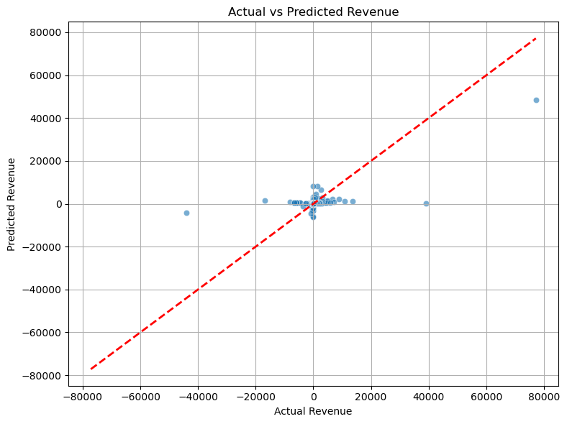
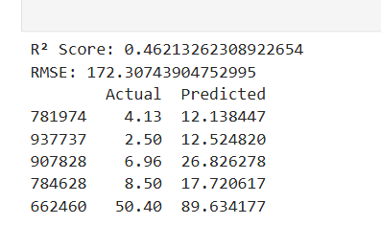
Actual vs Predicted Revenue
We used a Multiple Linear Regression to train and test the model.
The scatter plot of actual vs predicted revenue showed alignment near the ideal line.
The model performs well for most cases and gives reasonable predictions, especially within the normal transaction value range.
Some variance at higher revenue values indicates outliers or missing non-linear factors.

Slide 11
Conclusion & Recommendations
In this project, I have successfully built and evaluated a Linear Regression model to predict TotalRevenue from the Online_Retail_II dataset. The dataset was preprocessed by removing missing and invalid values, encoding categorical variables (like Country), and calculating TotalRevenue as a target variable.
After splitting the data into 80% training and 20% testing, the model was trained using Quantity, Price, and country variables as features. The performance was then evaluated using:
R² Score: Indicates how well the model explains the variance in revenue.
Root Mean Squared Error (RMSE): Measures the average error in the same unit as revenue.
The output shows that the model is able to capture the general revenue trends, but with some level of prediction error, likely due to outliers, missing variables (like product category or customer behavior), or non-linear effects.
We found that:
Linear regression provided useful insight, but adding more features improved model accuracy.
We recommend enriching the model with time-based variables, product categories, and customer behavior.
Outliers should be handled more robustly, and non-linear models like Random Forest or XGBoost could capture deeper interactions in future work.

Slide 12
Business Impact
Our model has practical implications:
It can help optimize inventory and staffing based on forecasted demand.
Marketing campaigns can be timed with identified sales peaks.
Customer segmentation and personalized offers can drive retention and revenue.

Slide 13
Thank You for your Attention!!

